Slide 1
HOW TO NOTES
(Final Presentation)
Student: Josiah Abel
Instructor: Lou Toth
Class: Circuit Analysis, EECT 111-50c

Slide 2
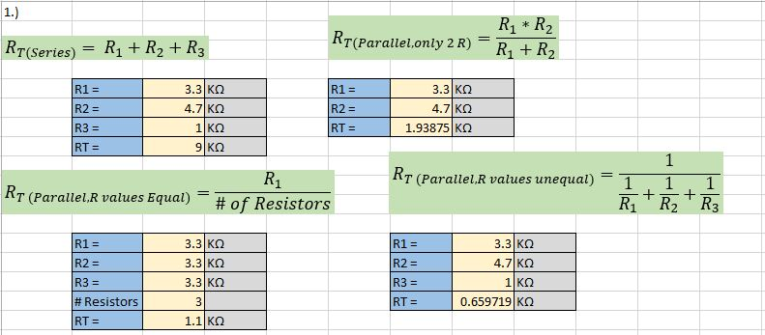
1.) How to Combine Resistors in Series or Parallel

Slide 3
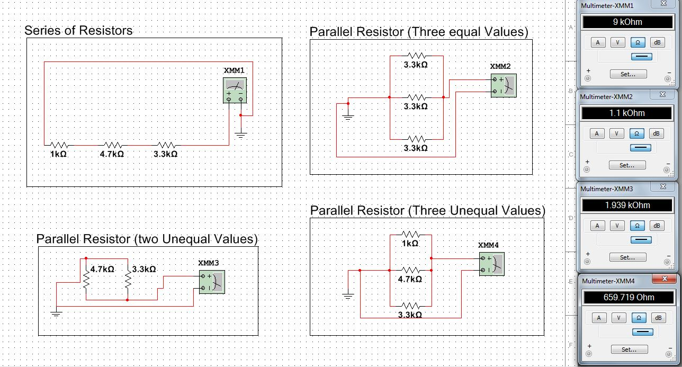
1.) How to Combine Resistors in Series or Parallel

Slide 4
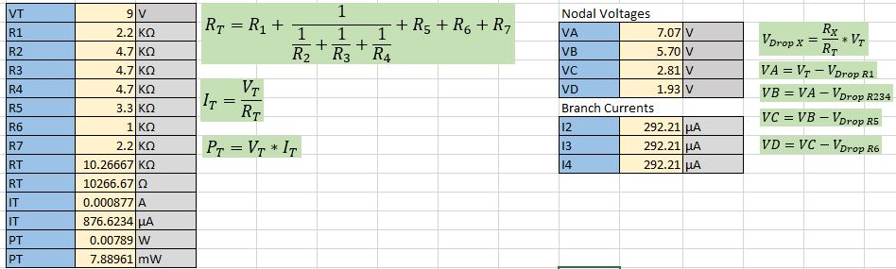
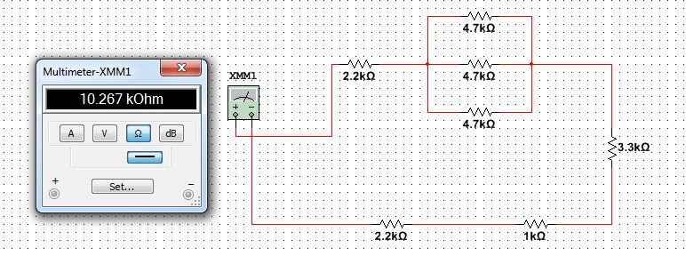
2.) How to, find RT , IT , PT , Nodal V, and Branch I’s In a Series/Parallel R Network
RT

Slide 5
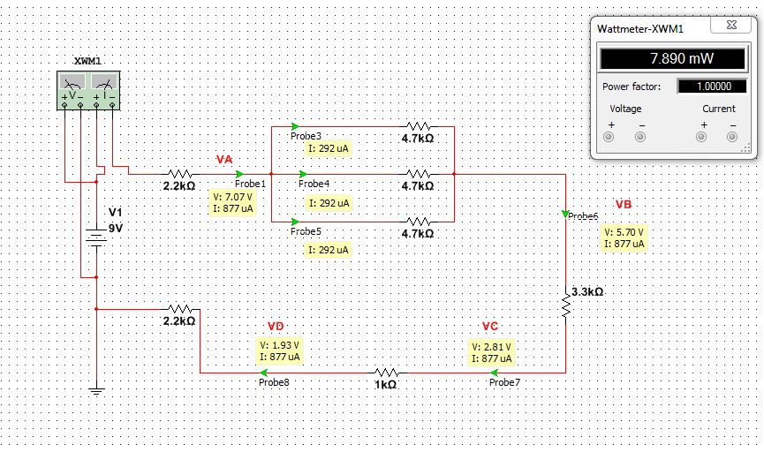
2.) How to, find RT , IT , PT , Nodal V, and Branch I’s In a Series/Parallel R Network
PT

Slide 6
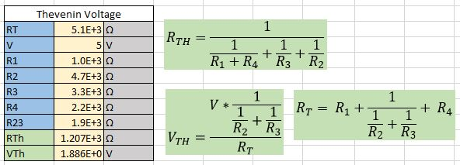
3.) How to, Find Thevenin Resistance and Voltage

Slide 7
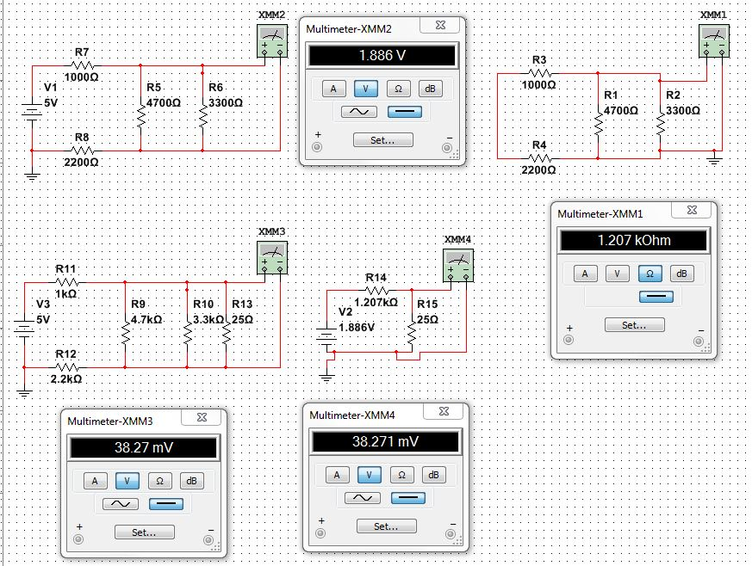
3.) How to, Find Thevenin Resistance and Voltage
VTH
RTH

Slide 8
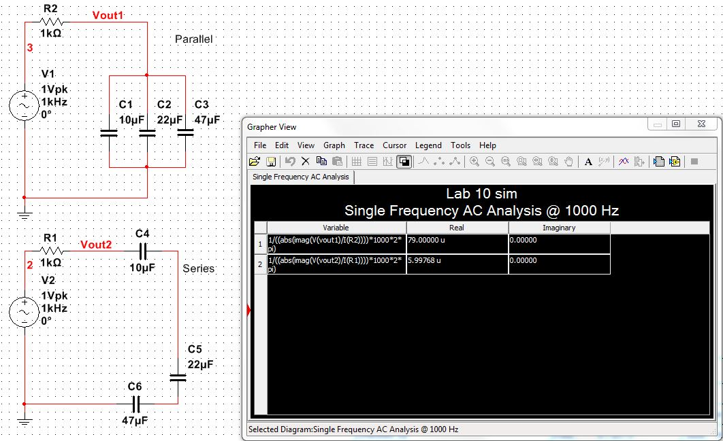
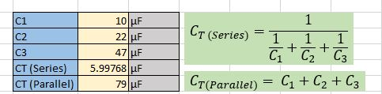
4.) How to Calculate CT In Series and Parallel

Slide 9
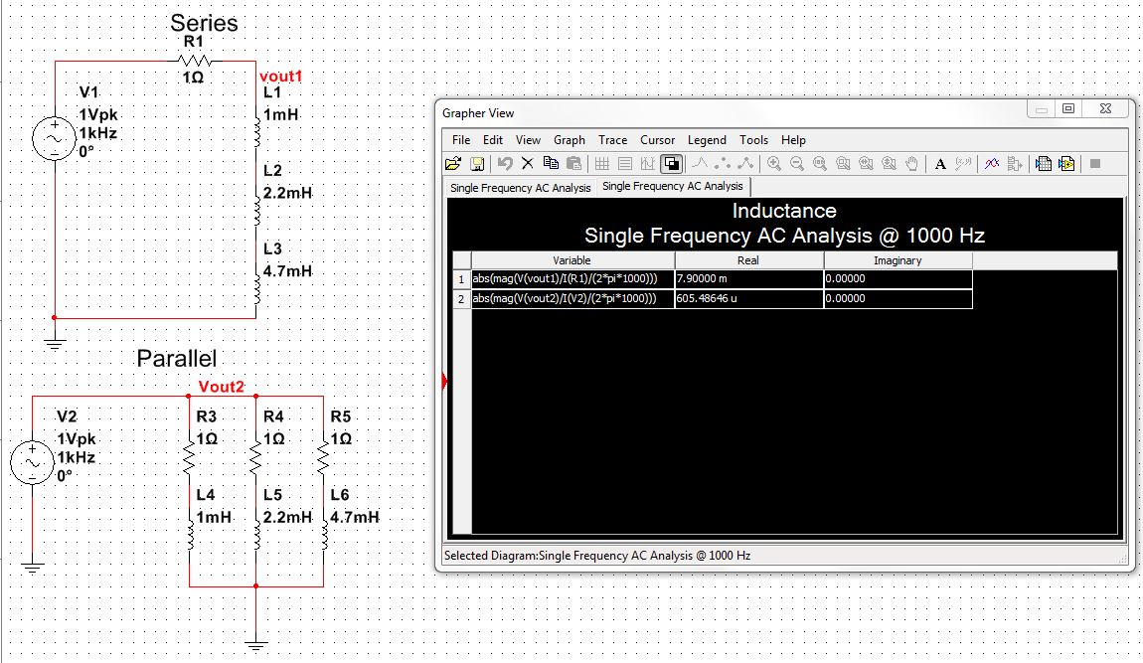
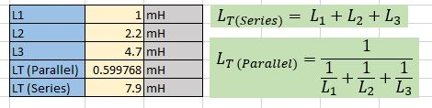
5.) How to Calculate LT in Series and Parallel

Slide 10
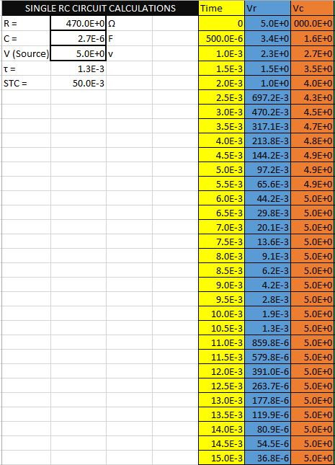
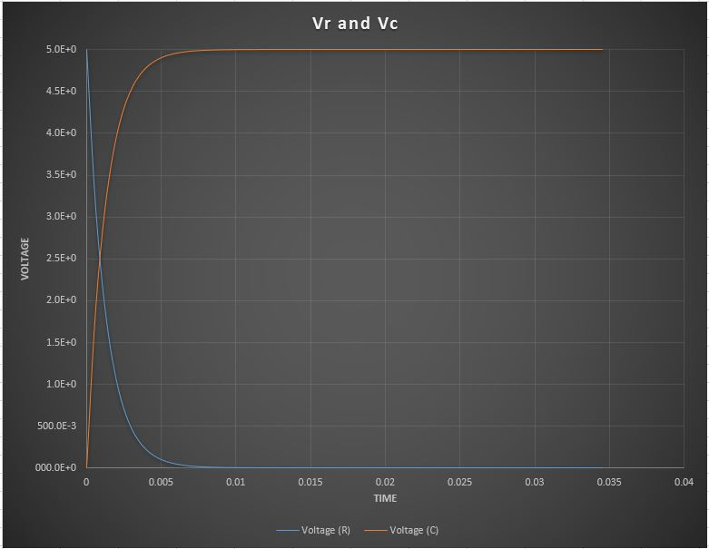
6.) How to, Use a simple RC Circuit to Find:
A. the time constant τ.
B. a graph that demonstrates τ as a function of time.

Slide 11
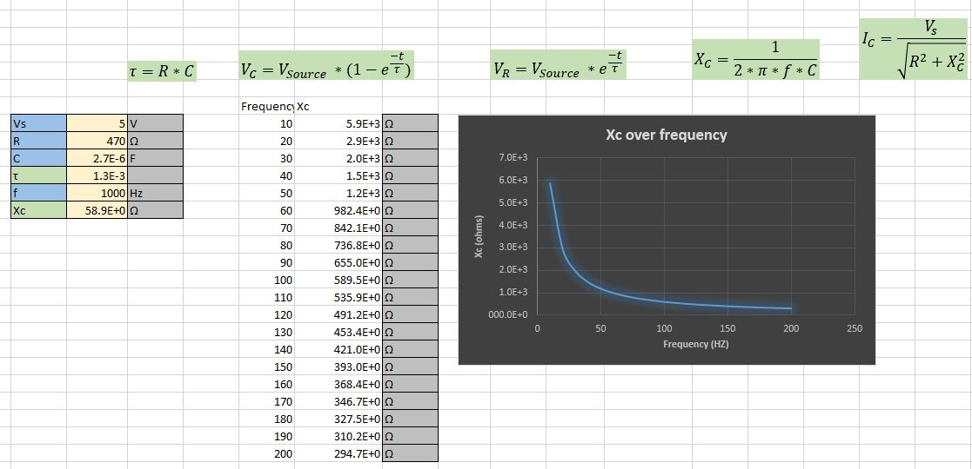
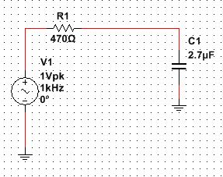
6.) How to, Use a simple RC Circuit to Find:
C. find Xc @ 1000 Hz.
D. a graph that demonstrates Xc as a function of frequency.

Slide 12
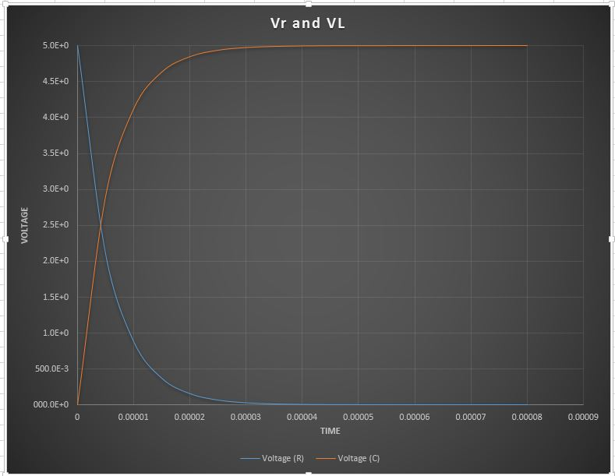
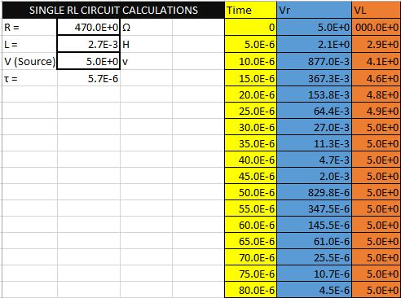

7.) How to, Use an RL Circuit to Find:
$$τ=\frac{L}{R}$$
A. the time constant τ.
B. a graph that demonstrates τ as a function of time.

Slide 13
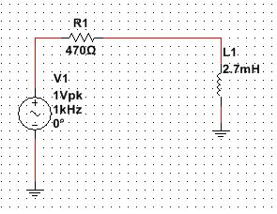
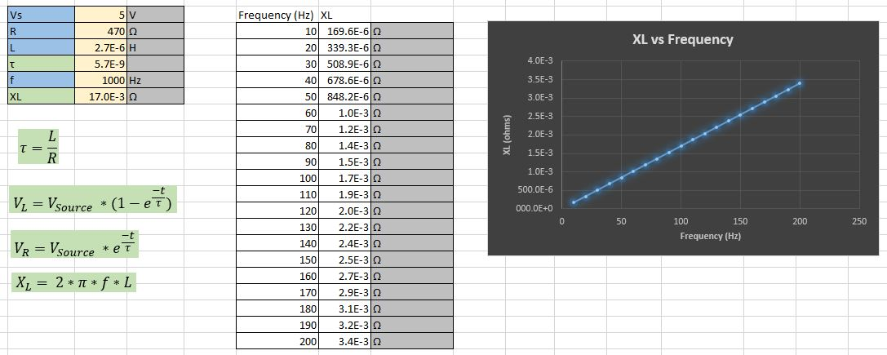
7.) How to, Use an RL Circuit to Find:
C. find XL @ 1000 Hz.
D. a graph that demonstrates XL as a function of frequency.

